Slide 1


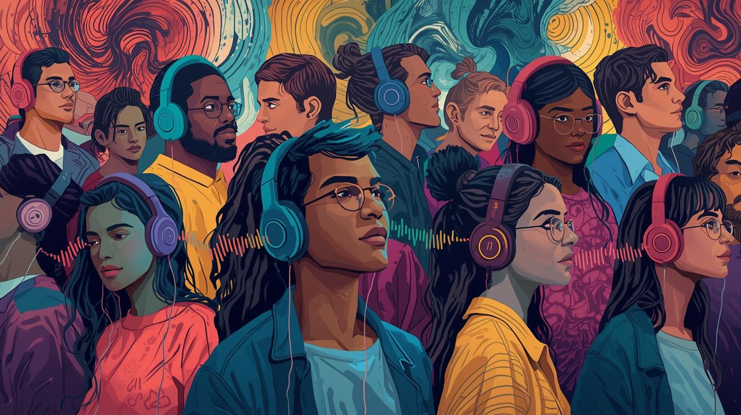
MoodMate
-AI that understands emotions & plays your vibe 🎶
Presented by
Veda Priya Mutyam

Slide 2

Problem Statement
Challenges in music selection today
Users struggle to find music that matches their emotions, as current systems require manual searching.

Slide 3
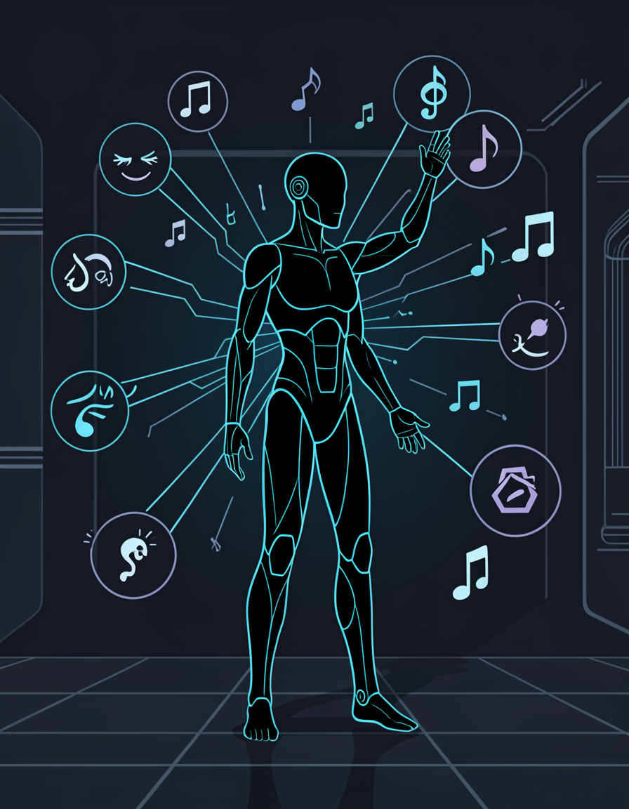
Project Overview
Objective:
The main objective of this project is to develop an intelligent music recommendation system that understands a user’s emotional state and suggests suitable music accordingly. The system aims to detect emotions through multiple input methods such as text, images, and webcam, and reduce the effort of manually searching for mood-matching songs.

Slide 4
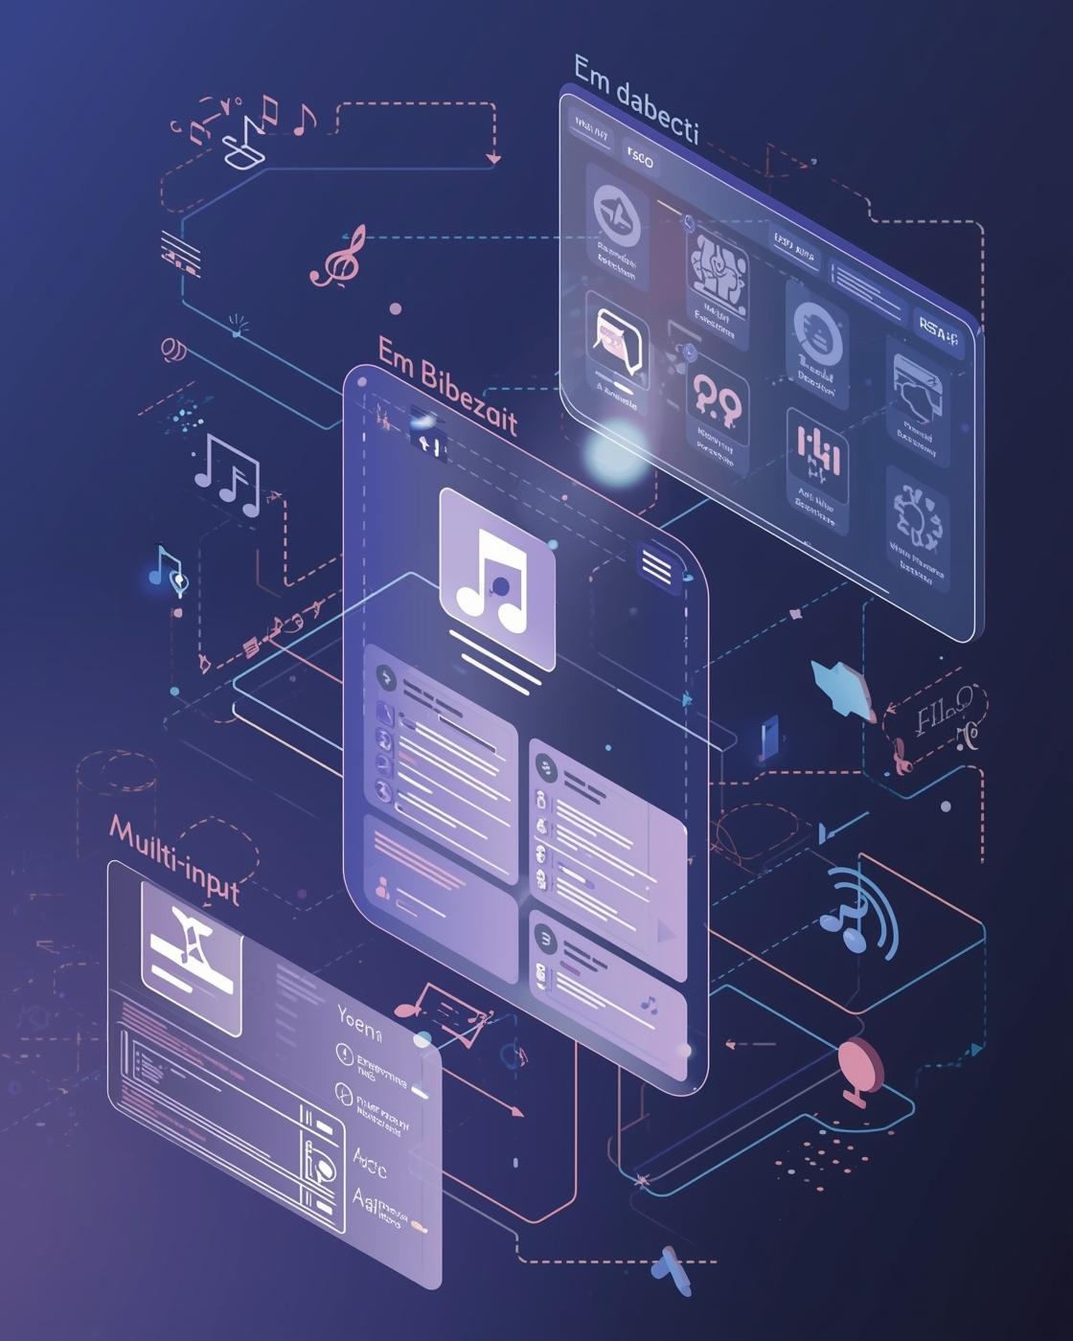
Project Overview
Outcomes:
• Successfully detects user emotions using AI models from text, facial images, and webcam input.
• Recommends personalized music based on the detected emotion.
• Provides direct access to songs through Spotify links for easy listening.
• Enhances user experience by offering emotion-aware, real-time music recommendations.
• Demonstrates the practical application of AI techniques in emotion recognition and recommendation systems.

Slide 5
Data Set Overview
📝 Text Emotion Dataset
Name: GoEmotion Dataset for NLP (e.g., Kaggle Emotion Dataset)
Overview:
Contains text sentences labeled with emotions such as happy, sad, angry, love, etc.
Used to train the Transformer (DistilBERT) model for text-based emotion detection.
🎥 Webcam Emotion Dataset
Name: DeepFace Pre-trained Emotion Model
Overview:
Uses a large-scale pre-trained facial emotion dataset internally.
Enables real-time emotion detection from webcam input.
📷 Facial Emotion Image Dataset
Name: FER-2013 (Facial Expression Recognition Dataset)
Overview:
Consists of grayscale facial images categorized into different emotions.
Used to train the CNN model for image-based emotion recognition.
🎵 Music Dataset
Name: **Million Song Dataset + Spotify + Last.fm**
(Custom / Kaggle)
Overview:
Contains song names, artists, mood-related text, audio features, and Spotify IDs.
Used for emotion-based music recommendation using TF-IDF and cosine similarity.

Slide 6
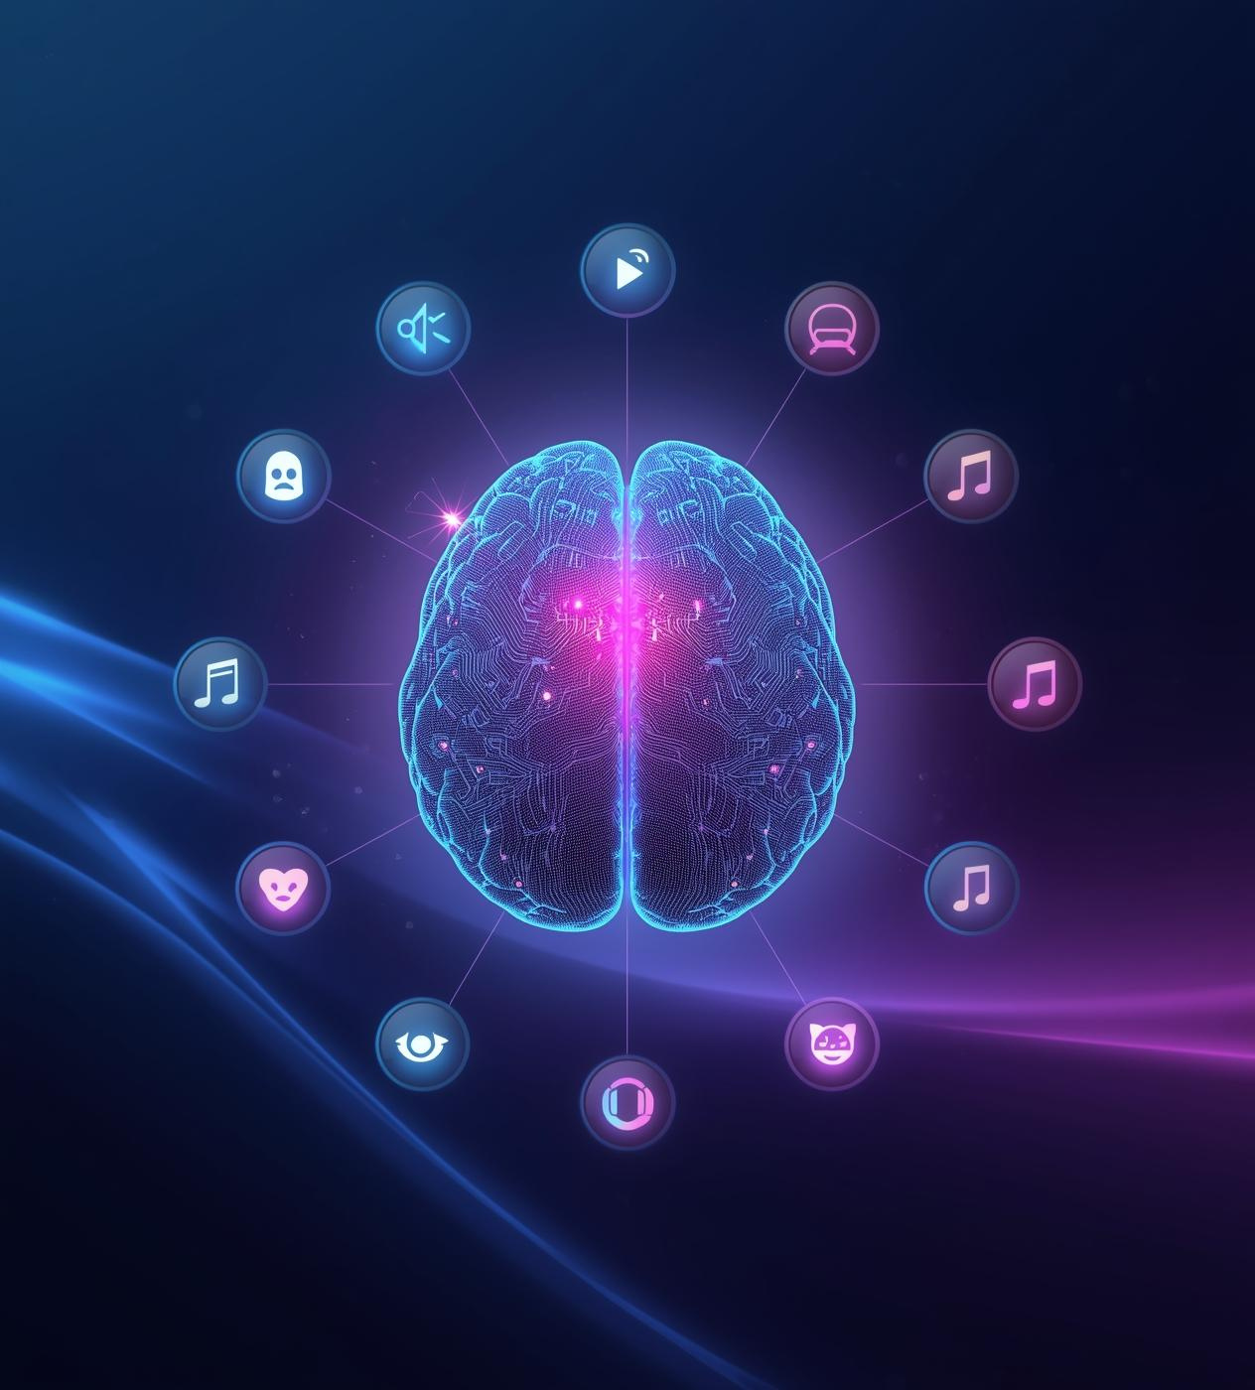
Proposed Solution
Emotion detection and music recommendation
The MoodMate system leverages AI to detect user emotions through various inputs, automatically recommending personalized playlists that match their current mood for an enhanced listening experience.

Slide 7
Key Features
Multi-Input Detection
AI Emotion Classification
Personalized Recommendations
Supports text, image, and webcam for emotion detection.
Accurately classifies emotions for personalized recommendations.
Suggests music tailored to the user’s current mood.
External Music Integration
Emotion Confidence Meter
History Tracking
Records user interactions and emotional trends over time.
Connects with popular music platform spotify for seamless access.
Displays confidence levels for detected emotions in real-time.

Slide 8
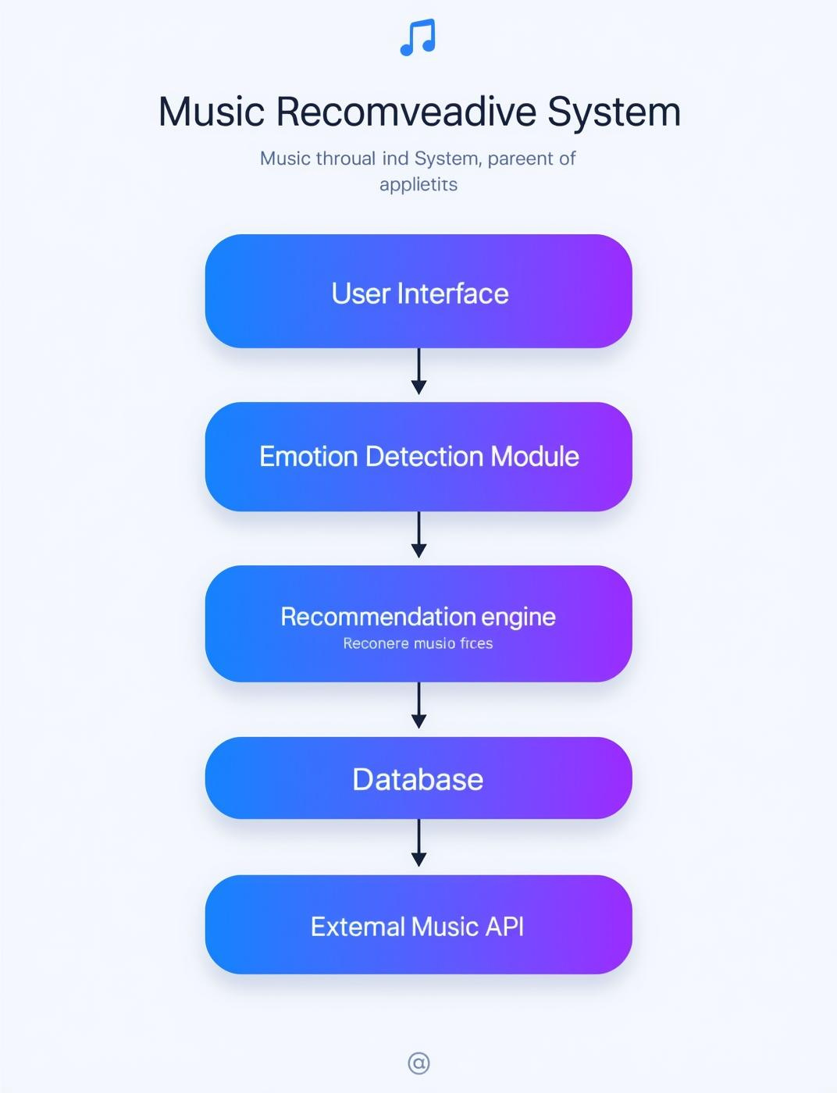
System Architecture
The MoodMate system architecture integrates multiple components to create a seamless user experience. It includes the User Interface for interaction, the Emotion Detection Module for analyzing user emotions, the Recommendation Engine for personalized music suggestions, and a Database for storing user data and preferences.

Slide 9
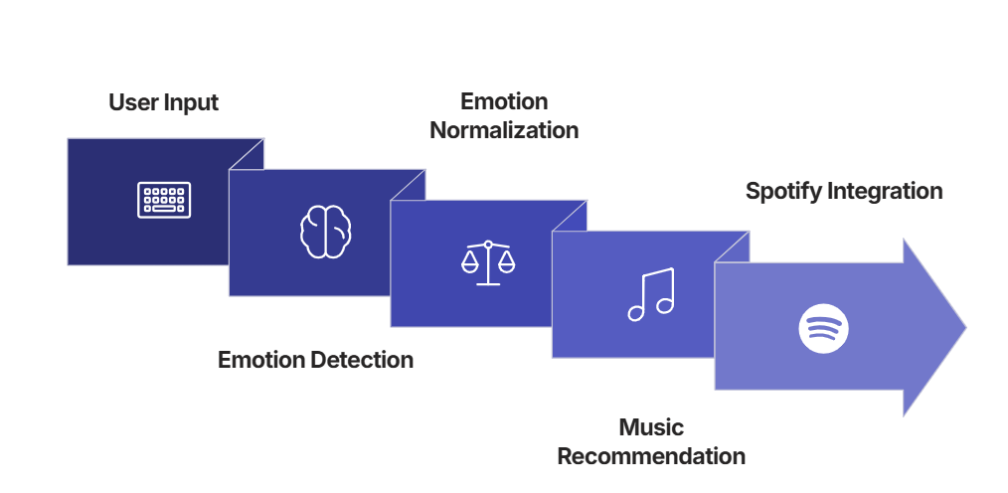
Workflow Process

Slide 10

Text Detection
The system leverages pre-trained NLP (Distil-BERT) models to analyze user input. By examining the text for emotional cues, it predicts the user's feelings, generating a confidence score for accuracy. This approach enables the MoodMate to tailor recommendations effectively based on textual expressions.

Slide 11
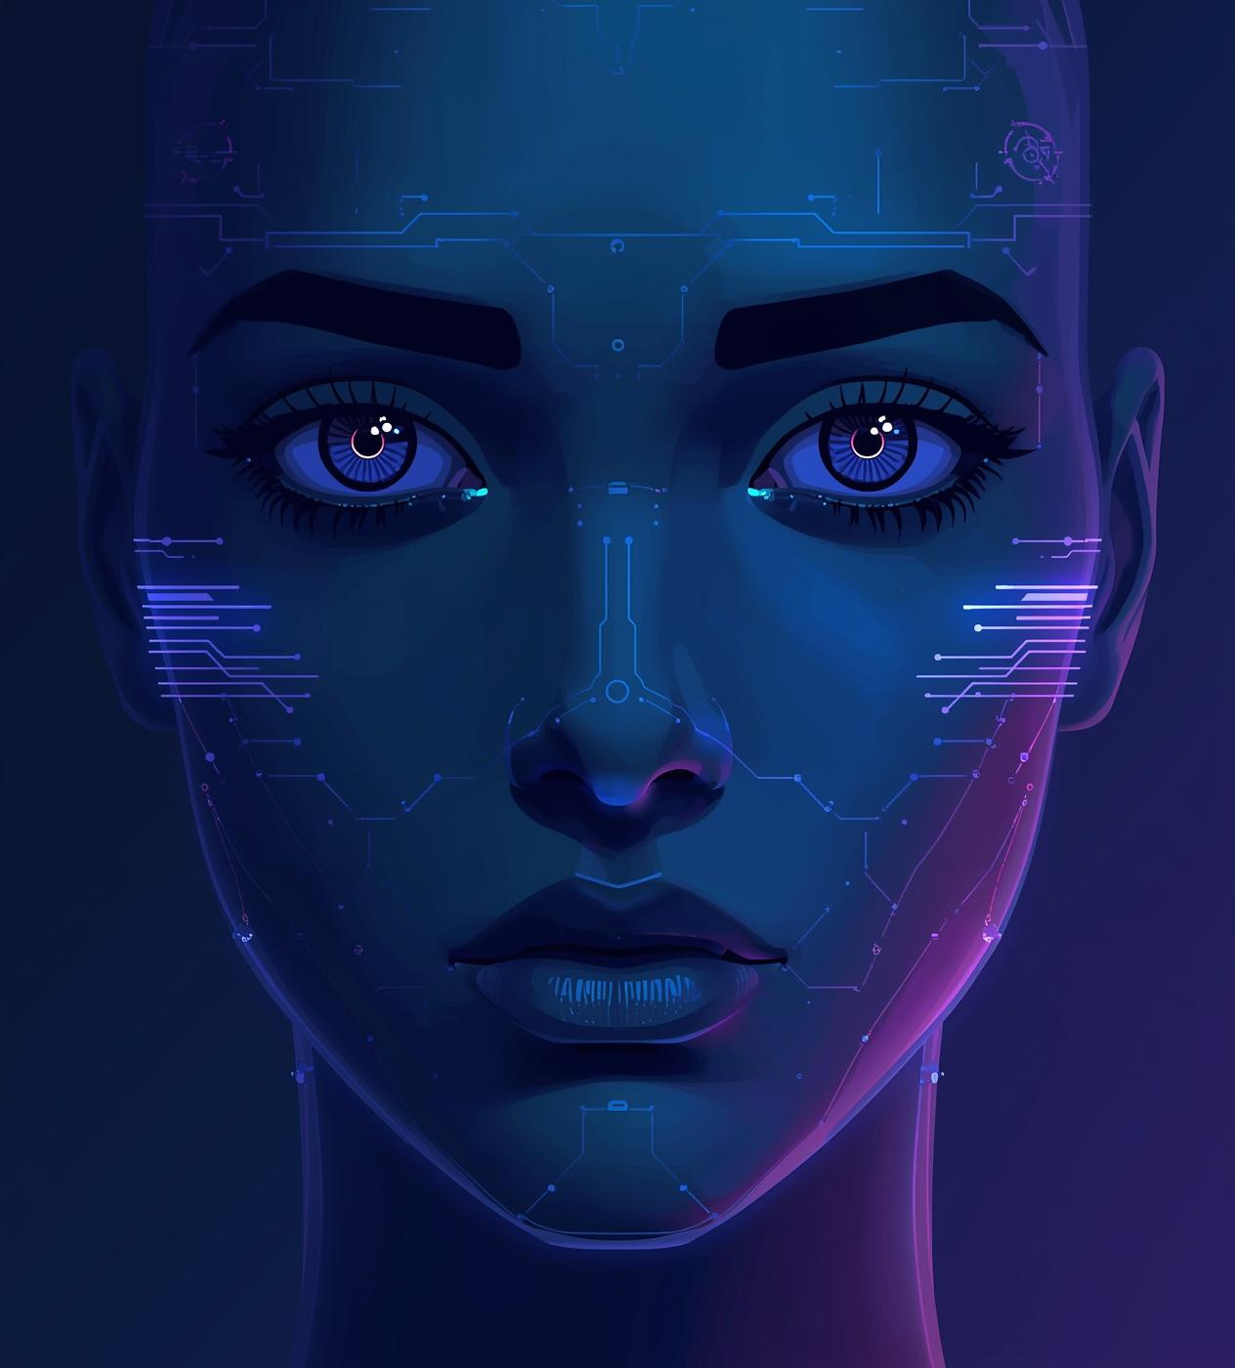
Image Detection
For image-based emotion detection, we utilize a Convolutional Neural Network (CNN) pre-trained on extensive facial emotion datasets.
Incoming images undergo crucial preprocessing steps including conversion to grayscale, resizing, and normalization. This optimized data is then fed to the CNN for precise emotion prediction and confidence scoring.

Slide 12

Web Cam Detection
Real-time Face Capture
Capturing live facial expressions continuously.
DeepFace Analysis
Applying the DeepFace framework for advanced facial emotion analysis.
Dominant Emotion Extraction
Identifying and extracting the most prominent emotion for recommendation.

Slide 13
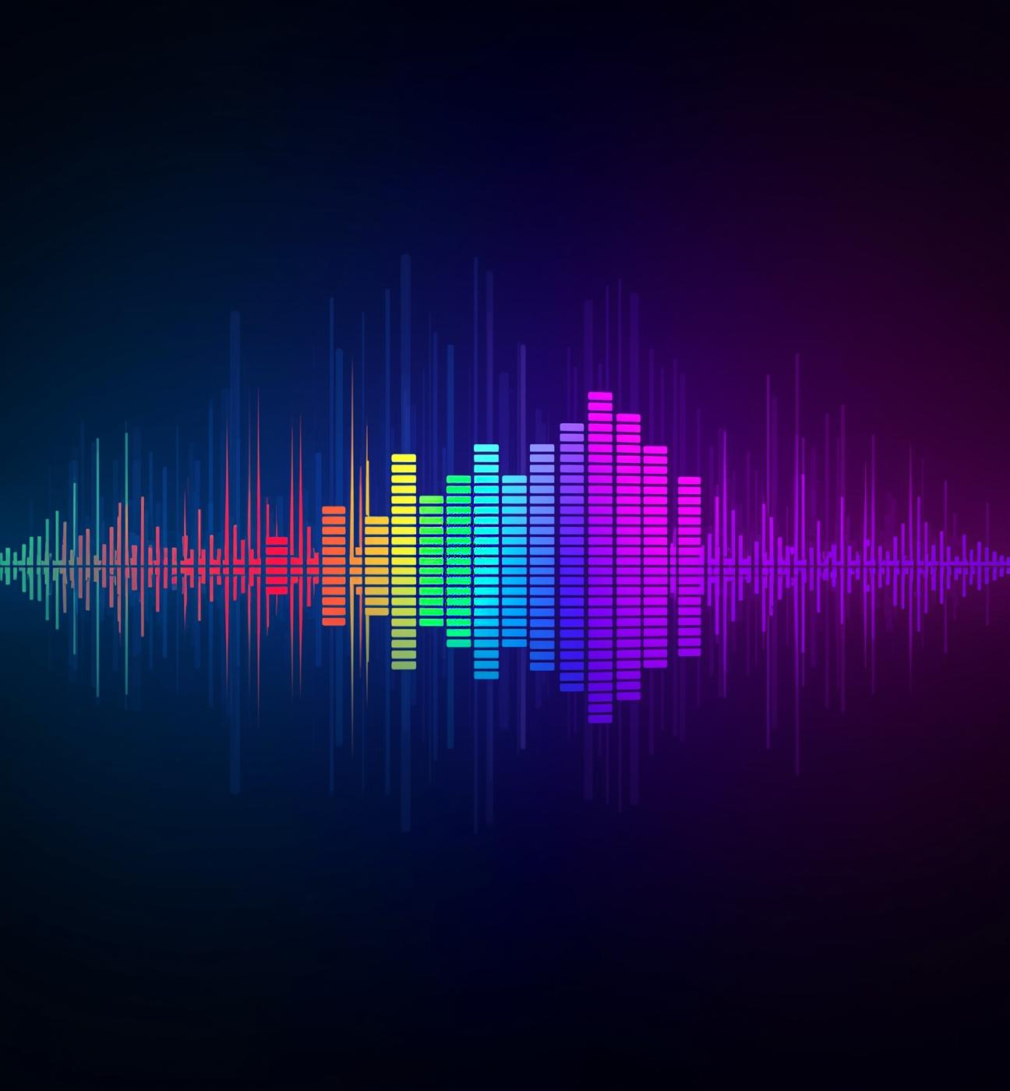
Recommendation Engine
The Recommendation Engine analyzes user emotions to provide personalized song selections. By extracting text features and matching them with the mood of available songs, it generates tailored playlists, ensuring that the music resonates deeply with the user's current feelings and enhances their experience.

Slide 14
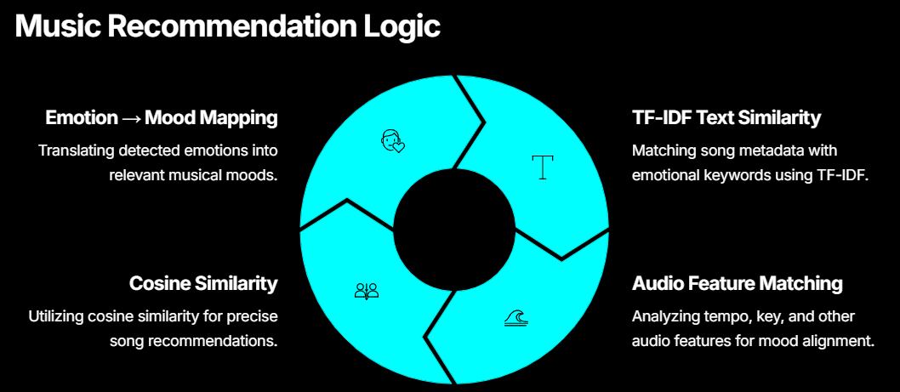

Slide 15
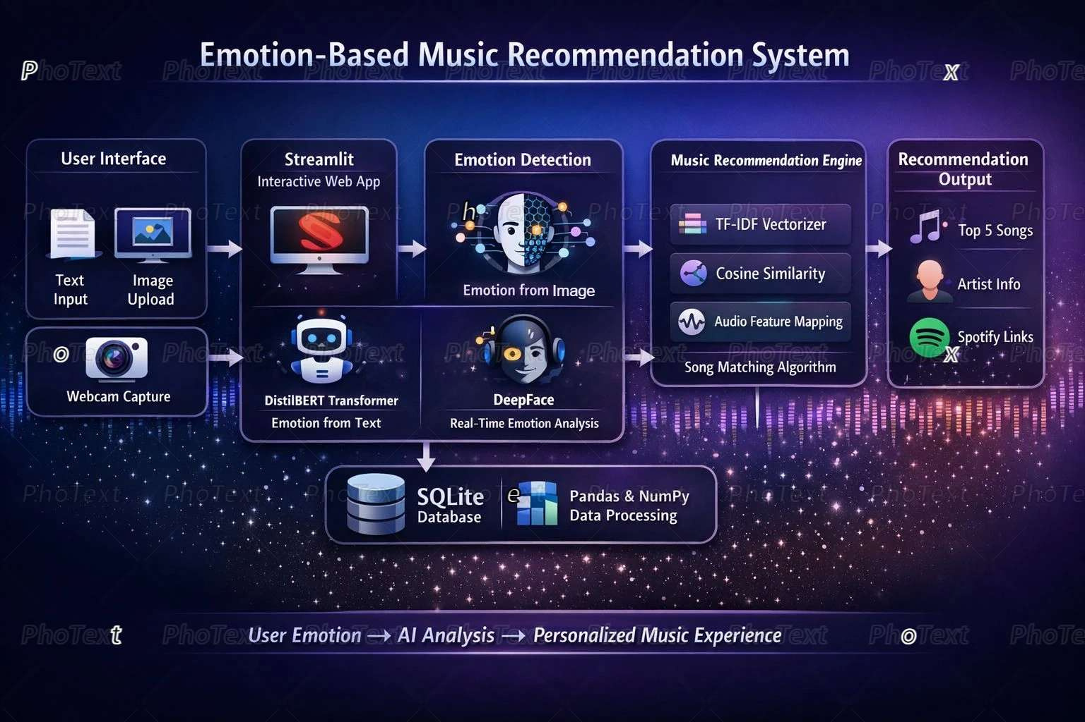
Technologies Used:
Python
Streamlit
TensorFlow
Keras
PyTorch
DistilBERT
DeepFace
OpenCV
TF-IDF
Cosine Similarity
SQLite

Slide 16
Advantages
Customized user experiences enhance engagement and satisfaction
Multiple input methods ensure accessibility for everyone
Users receive tailored music choices for their moods.
Users can choose from text, image, or webcam input.
Instant recommendations provide seamless listening experiences
Intuitive interface makes navigation easy for all users
Music is suggested based on real-time emotional analysis.
Clear design ensures a user-friendly interaction for everyone.

Slide 17

Conclusion
The MoodMate system enhances user experiences by intelligently adapting to emotional states. Future enhancements may include voice emotion detection, more personalized learning algorithms, playlist generation, and a mobile app version, ensuring a broader reach and improved interaction for users worldwide.

Slide 18

Thank You!

